Slide 1

PRESENTATION
OF
PORTABLE SWACHALAYA
READY-MADE
TOILET BLOCK
POLYMAT INDUSTRIES
MANUFACTURED BY :
POLYMAT INDUSTRIES
ASIDC INDUSTRIAL COMPLEX
BONDA, NARENGI, GUWAHATI-781026
E mail ID: prakashgh53@gmail.com
Web ID : www.polymat.in

Slide 2

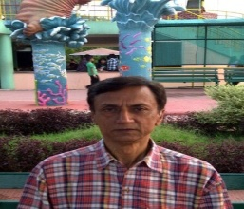
POLYMAT INDUSTRIES

Slide 3
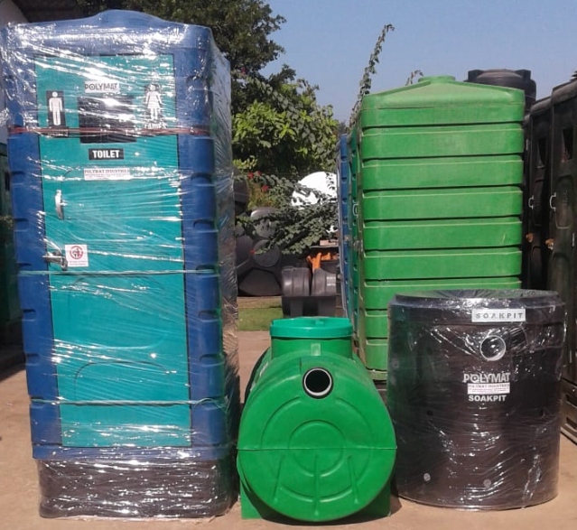
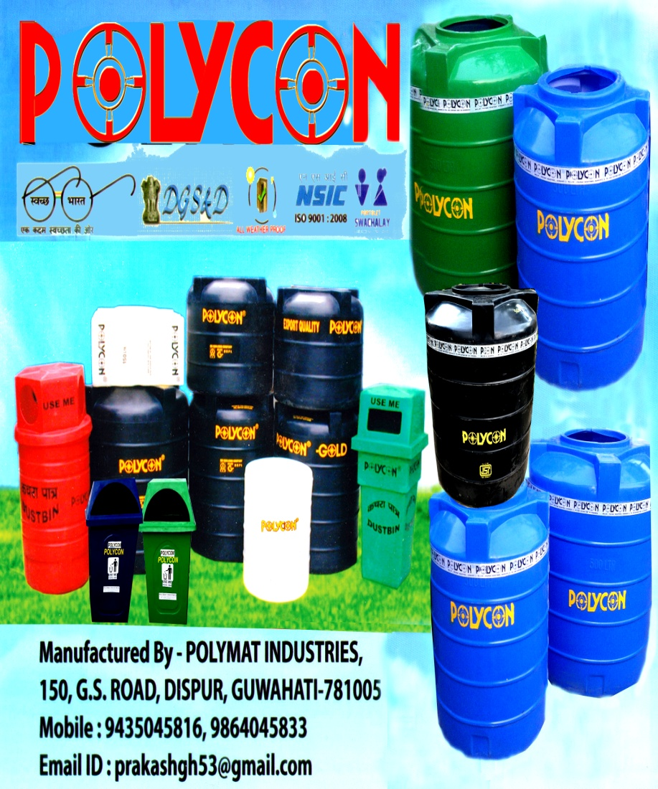
PRODUCTS
POLYMAT INDUSTRIES

Slide 4

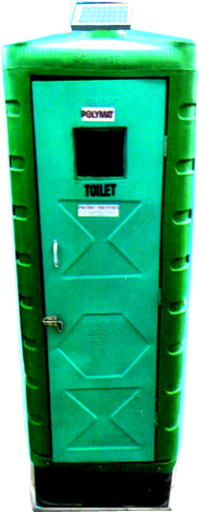
POLYMAT INDUSTRIES

Slide 5
ROTATIONAL MOULDED PORTABLE SARAL SWACHHALAYA TOILET BLOCK
Under Swachh Bharat Abhiyan Scheme Govt. approval and design suitable for wind conditions and seismic Zone V saral swachhalaya Toilet blocks with Single PAN unit made from Rotational Moulded Virgin heavy duty Plastic materials.
POLYMAT INDUSTRIES

Slide 6

POLYMAT INDUSTRIES is a broadband visionary who has introduced innovative products manufactured at Guwahati,Assam under registered trade mark
POLYMAT INDUSTRIES

Slide 7
BIO TOILET Blocks in Single moulded Indian Style PAN, European Style block, Urinal style block, Bathroom block , Septic Tanks,Soak Pit is ready made totally maintenance free, easy to carry & install within a short time at any desired places in a minimum areas.
POLYMAT INDUSTRIES

Slide 8
ASSESSMENT
According to UNICEF, W.H.O. estimate 1/7th of the World Population still uncongenial method in the absence of TOILET of this 60% LIVES IN INDIA. The Global impact of Poor sanitation specially in Rural & Urban Area of Indian communities specially Children, women health is affected.
POLYMAT INDUSTRIES
REMEDY
BIO – TOILET : A complete solution to install Ready Made Portable Toilet Blocks.

Slide 9
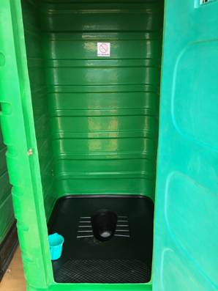
TOILET BLOCK SINGLE PAN INDIAN STYLE
# Virgin heavy duty UV stabilized Plastic Materials,moulded Indian Pan
#Available Knock- down condition fitted with water tap ,Alluminiun handle,SS/Allmn. Door Closing lock system.
#Corrosion resistance Dust free -Smell proof,easy to clean & drying ,quick and easy installation
#Connect outlet with Septic Tank Or Soak Pit Or Other attachment
POLYMAT INDUSTRIES

Slide 10
SPECIFICATION OF THE POTABLE PLASTIC TOILET BLOCK
Sl No. | PORTABLE TOILET INDIAN PAN SYSTEM
1 | PRODUCT | Heavy Duty 100% virgin UV Stabilized Plastic Portable Toilet
2 | SYSTEM | Indian type moulded single INDIAN PAN
3 | OVER ALL DIMENSION | Length 1.100 meter x Width 0.905 meter x Height 2.270 meter
4 | DIMENSION OF MAIN CABIN | 1.060 meter Long x 0.900 meter width x 1.820 meter Height AND 5 MM +/- Thickness of Plastic molded toilet cabin
5 | DIMENSION OF BOTTOM BOX | 1.060 meter Long x 0.900 meter width x 0.350 meter Height Double Layered 60 mm heavy duty Box in Single Moulded Indian PAN
6 | DIMENSION OF CABIN DOOR | Heavy duty moulded plastic door 1.700 meter height x 0.595 meter width and 30 mm thickness with 250 mm x 200 mm open Jhali ventilation fitted with Door lock system
7 | OUT LET SYSTEM | PVC P-Trappe/Bend for out let system of Sludge
8 | PLUMBING FITTING | Piping & Plumbing fitting will be done by buyer
9 | GUARANTEE | One Year Guarantee of any manufacturing defect But NO Guarantee for wear, tear, damage, mishandling etc
POLYMAT INDUSTRIES

Slide 11
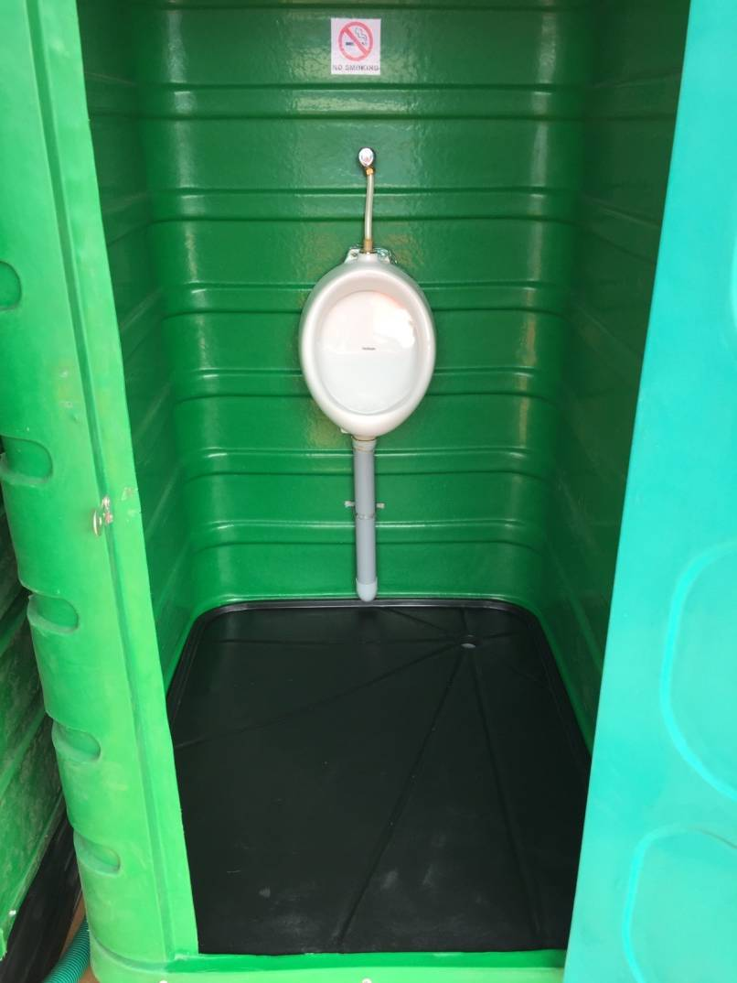
URINAL STYLE BLOCK
#Virgin heavy duty U.V.Stabilized Plastic Material,fitted with Urinal Pan
#Available in knock- down condition fitted with water tap connection,Alluminium handle, Door Closing Syatem.
#Maintenance free , attractive, durable, Corrosion resistance,Dust free-smell proof,Clean & quick dry,Space saving and easy to installation
Connect outlet direct to Drain or Soak Pit Or other attachment.
POLYMAT INDUSTRIES

Slide 12
B. PORTABLE URINAL SYSTEM
1 | PRODUCT | Heavy Duty 100% virgin UV Stabilized Plastic Portable Urinal Cabin
2 | SYSTEM | Fitted Porcelain Urinal Pan with Outlet pipe connection
3 | OVER ALL DIMENSION | Length 1.100 meter x Width 0.905 meter x Height 2.270 meter
4 | DIMENSION OF MAIN CABIN | 1.060 meter Long x 0.900 meter width x 1.820 meter Height and 5 MM +/-Thickness of Plastic molded Urinal cabin
5 | DIMENSION OF BOTTOM BOX | 1.060 meter Long x 0.900 meter width x 0.350 meter Height Double Layered 60 mm gape heavy duty Box in Moulded Plain Floor
6 | DIMENSION OF CABIN DOOR | Heavy duty moulded plastic door 1.700 meter height x 0.595 meter width and 30mm thickness with 250 mm x 200 mm open Jhali ventilation with Door lock system
7 | GUARANTEE | One Year Guarantee of any manufacturing defect But NO Guarantee for wear, tear, damage, mishandling etc
POLYMAT INDUSTRIES

Slide 13
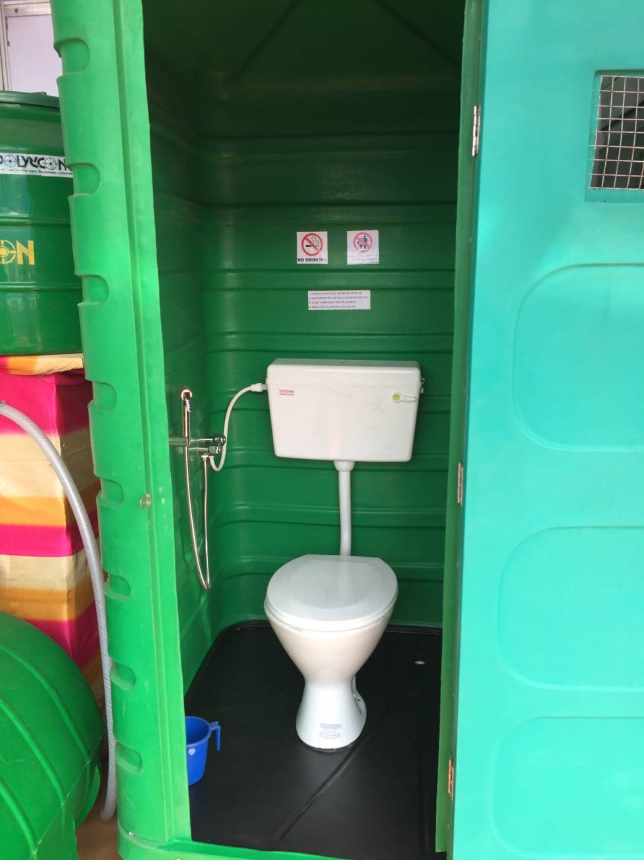
TOILET BLOCK EUROPEAN STYLE
#European Style fitted with Porcelain EWC with Flush Cistern,Water tape,Cloth hanger condition
#Available knock-down condition fitted with Alluminium handle,SS Door Closing Lock system.
#Maintenance free, Dust free-Smell proof, easy to clean & quick dry and easy to installation
#Connect outlet with Septic Tank Or Soak Pit Or other attachment
POLYMAT INDUSTRIES

Slide 14
C . PORTABLE TOILET EUROPEAN STYLE SYSTEM
1 | PRODUCT | Heavy Duty 100% virgin UV Stabilized Plastic Portable Toilet Cabin
2 | SYSTEM | Porcelain European style commode with cistern fitted
3 | OVER ALL DIMENSION | Length 1.100 meter x Width 0.905 meter x Height 2.270 meter
4 | DIMENSION OF MAIN CABIN | 1.060 meter Long x 0.900 meter width x 1.820 meter Height AND 5 MM +/- Thickness of Plastic molded toilet cabin
5 | DIMENSION OF BOTTOM BOX | 1.060 meter Long x 0.900 meter width x 0.350 meter Height Double Layered 60 mm gape heavy duty Box in Moulded Plain Floor
6 | DIMENSION OF CABIN DOOR | Heavy duty moulded plastic door 1.700 meter height x 0.595 meter width and 30 mm thickness with 250 mm x 200 mm open Jhali ventilation with Door lock system
7 | FITTINGB STYLE | Fitted with Porcelain European Commode with Plastic Cistern and inlet water tape and Sprayer tape etc.
8 | PLUMBING & FITTING | Installation and Plumbing & Piping system will be done by buyers
9 | GUARANTEE | One Year Guarantee of any manufacturing defect But NO Guarantee for wear, tear, damage, mishandling etc
POLYMAT INDUSTRIES

Slide 15
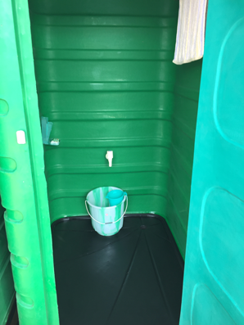
BATHROOM STYLE BLOCK
#Virgin heavy duty U.V.Stabilized Plastic Material,fitted with water tape ,cloth/towel hanger.
#Available in knock- down condition fitted with water tap connection,Alluminium handle, Door Closing Syatem.
#Maintenance free , attractive, durable, Corrosion resistance,Dust free-smell proof,Clean & quick dry,Space saving and easy to installation
Connect outlet direct to Drain Or other attachment.
POLYMAT INDUSTRIES

Slide 16
D. PORTABLE BATH SYSTEM
1 | PRODUCT | Heavy Duty 100% virgin U.V.Stabilized Plastic Portable Bath Cabin
2 | SYSTEM | Fitted with In let water tap for bath
3 | OVER ALL DIMENSION | Length 1.100 meter x Width 0.905 meter x Height 2.270 meter
4 | DIMENSION OF MAIN CABIN | 1.060 meter Long x 0.900 meter width x 1.820 meter Height and 5 MM +/- Thickness of Plastic molded toilet cabin
5 | DIMENSION OF BOTTOM BOX | 1.060 meter Long x 0.900 meter width x 0.350 meter Height Double Layered 60 mm heavy duty Box in Moulded plain Floor
6 | DIMENSION OF CABIN DOOR | Heavy duty moulded plastic door 1.700 meter height x 0.595 meter width and 30 mm thickness with 250 mm x 200 mm open Jhali ventilation
7 | GUARANTEE | One Year Guarantee of any manufacturing defect But NO Guarantee for wear, tear, damage, mishandling etc
POLYMAT INDUSTRIES

Slide 17
Special Feature
Maintenance Free
Easy To Install
Economical Viable
No Dependence on limited & Costly Conventional
energy sources
Required Portable septic Tank for Indian Pan
Attractive & Durable
Permit to use Toilet Cleaning Agent
Less Space required
Low Cost Simple Design
No need of connectivity to the Sewage Line
Eco friendly Disposable Connection & Recyclable
Available in Attractive colours
POLYMAT INDUSTRIES

Slide 18
Advantages
Wide applicability
Easy to cleaning
Minimize water consumption
No disposable sludge required
Easy to dismantle & install as desired place
Cost effective
Suitable for less space
Customized & easy adoptable
Organic waste reduction
Suitable for any geo-climate condition
Long ability
Environment friendly
Eco friendly for hill terrain area
POLYMAT INDUSTRIES

Slide 19
APPLICATIONS…
Homes
Farmhouses
Construction sites
Grounds & Exhibitions
Gardens & Forest
Golf courses
Public Places
Panchayat & Villages
City and Towns
Highways
Road side Dhabas
Bus, Taxi & others terminals
Railways & Railways Tracks
Boarder security forces
Boarder Road organization
Defence
And any places as required…………
POLYMAT INDUSTRIES

Slide 20
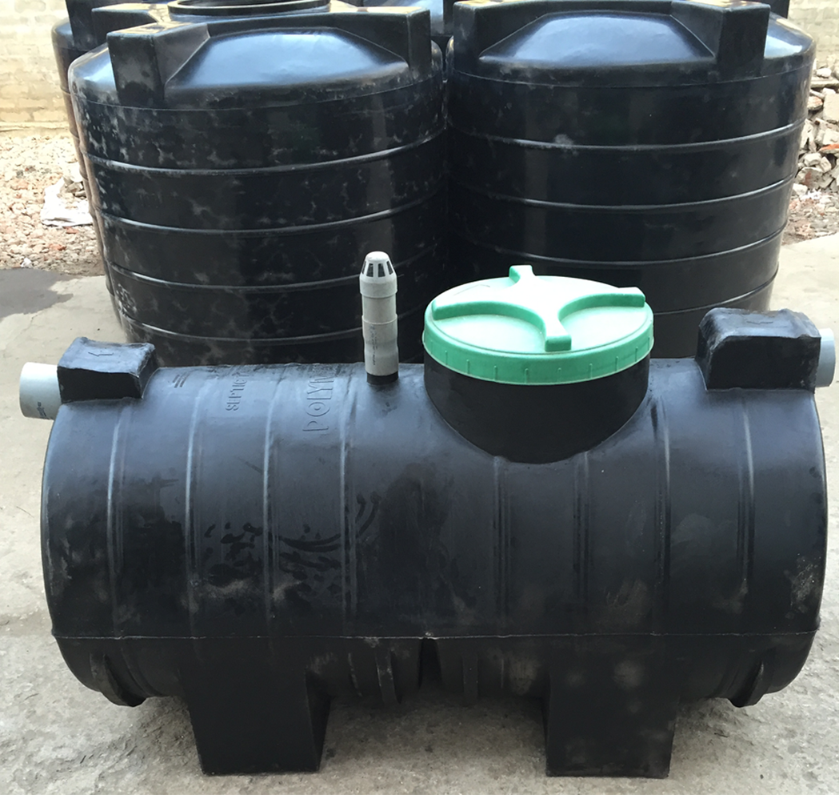
SEPTIC TANK
Made of 100% Virgin U.V.Stabilized heavy duty Plastic Material.
Fitted with 110 mm Socket for pipe in let & out let with easy connection.
Easy to handle & direct installation.
Long life.
Size : 500/1000 Litre capacity.
POLYMAT INDUSTRIES

Slide 21
E. SEPTIC TANK
1 | PRODUCTS | 100% Virgin heavy duty U.V.Stabilized plastic portable septic tank
2 | CAPACITY & SIZE | *500 Liter 1.450 meter length x 0.700 meter Dia x 0.740 meter Height *1000 Liter Length 2.100 meter X Dia 0.810 meter x Height 0.910 meter with 400 mm manhole screw Lide
3 | IN LET & OUT LET | To be connect 110 mm Inlet PVC Pipe Direct to the Septic Tank and Out let pvc pipe to Soak pit or Drain
4 | ISTALLATION | Easy to install withing short time
5 | STORAGE | No Storage of recycle water
6 | QUALITY | Environment friendly and cost effective
7 | GUARANTEE | One year Manufacturing Guarantee
POLYMAT INDUSTRIES

Slide 22
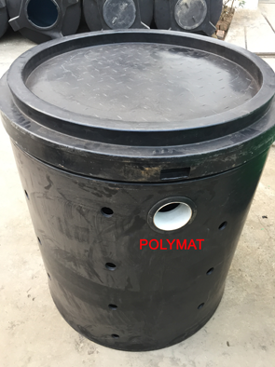
SOAK PIT
Made of 100% Virgin heavy duty U.V.Stabilized Plastic Material.
Fitted with 110 mm Socket for inlet pipe connection.
Easy to handle & installation . Long life.
Size : H:-950 X D:-870 mm
POLYMAT INDUSTRIES

Slide 23
INSTALLATION GUIDELINE :
Select space with filled dry Sand Or Soft Soil to cover inside bottom Box of the Down Toilet Body After Sealant to fixed P-Trap/Bend at site from out let of Indian Pan Toilet .
Cover Bottom with 5-6” Of Bricks with Mortar to protect movement of the Toilet Body.
For Discharge – to Fix 110 mm PVC pipe fitting connection with Out let of P- Trap/Bend direct connect to soak or Septic Tank Or Other as usual.
Septic Tank Or Soak Pit or Bio Tank can be Installed underground or Place on Floor subject to slop condition of out going of discharge.
For Soak Pit to be filled with brick stone inside and out side of the Pit top soaked the effluent need no out let discharge.
Next day it may be used as usual.
POLYMAT INDUSTRIES

Slide 24
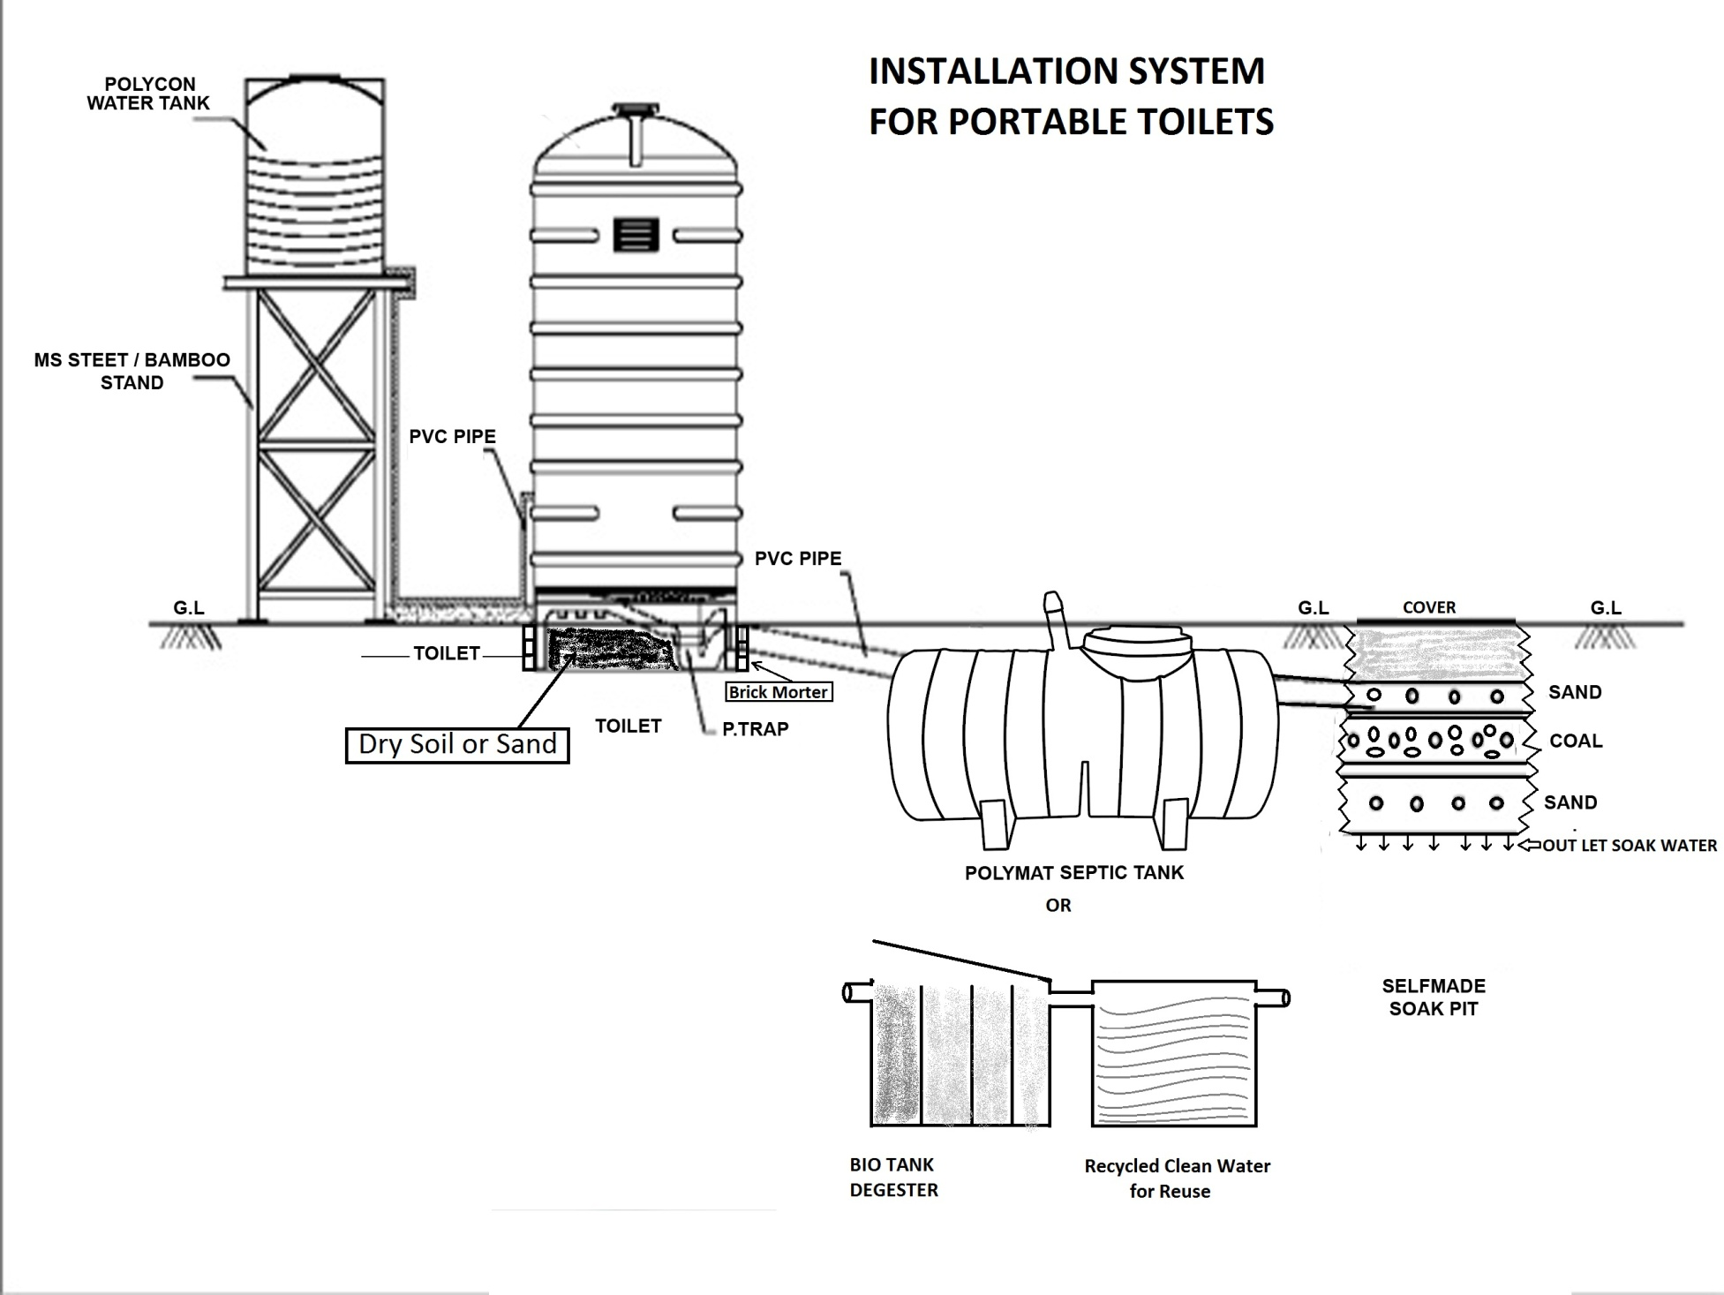
POLYMAT INDUSTRIES

Slide 25
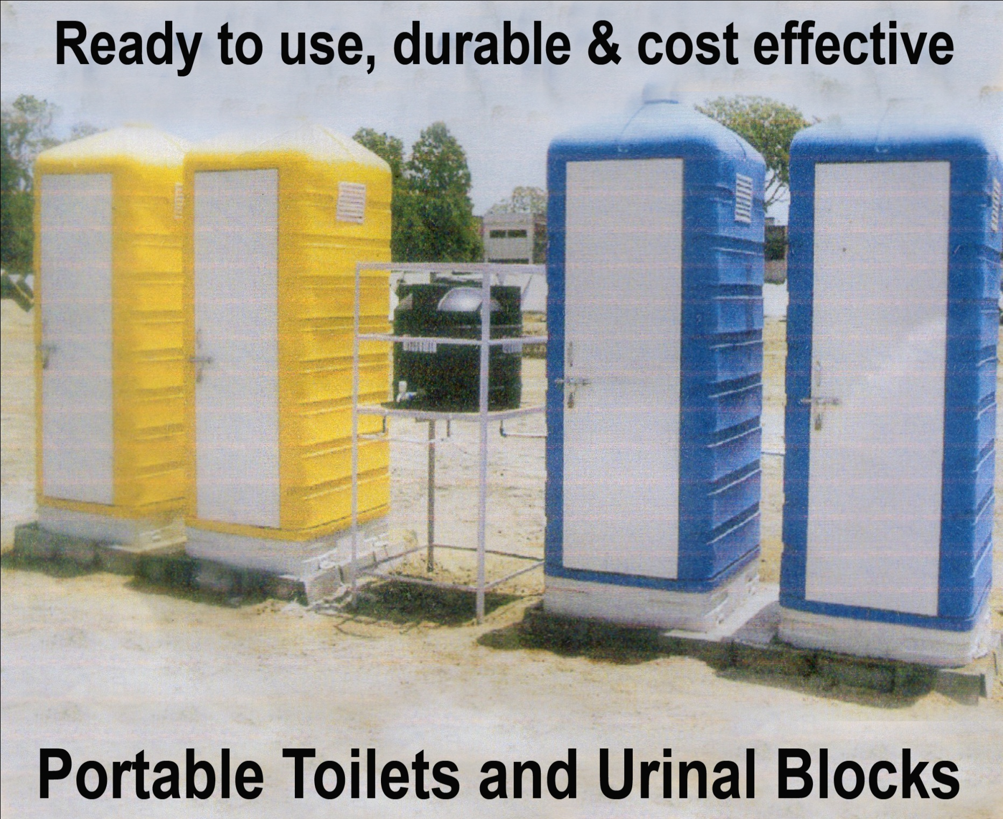
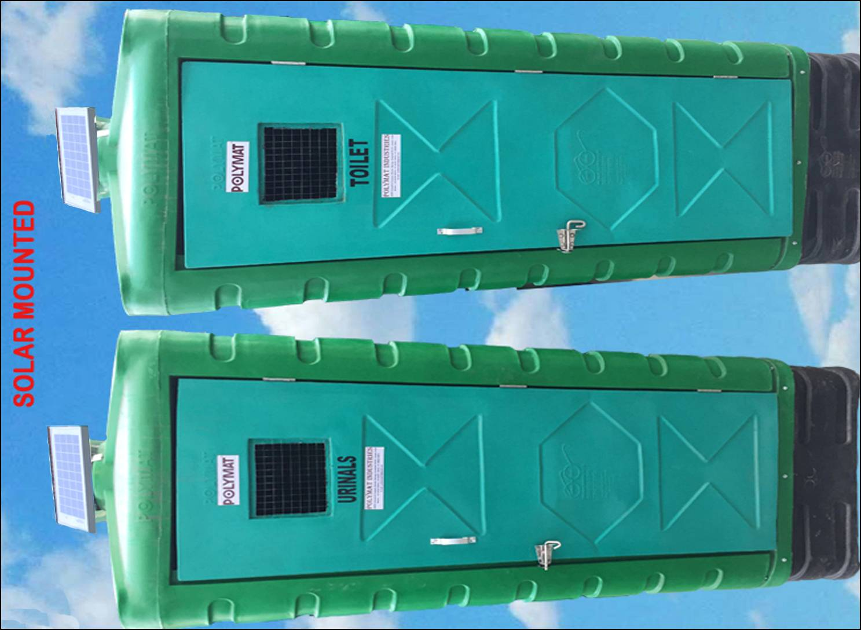
POLYMAT INDUSTRIES

Slide 26
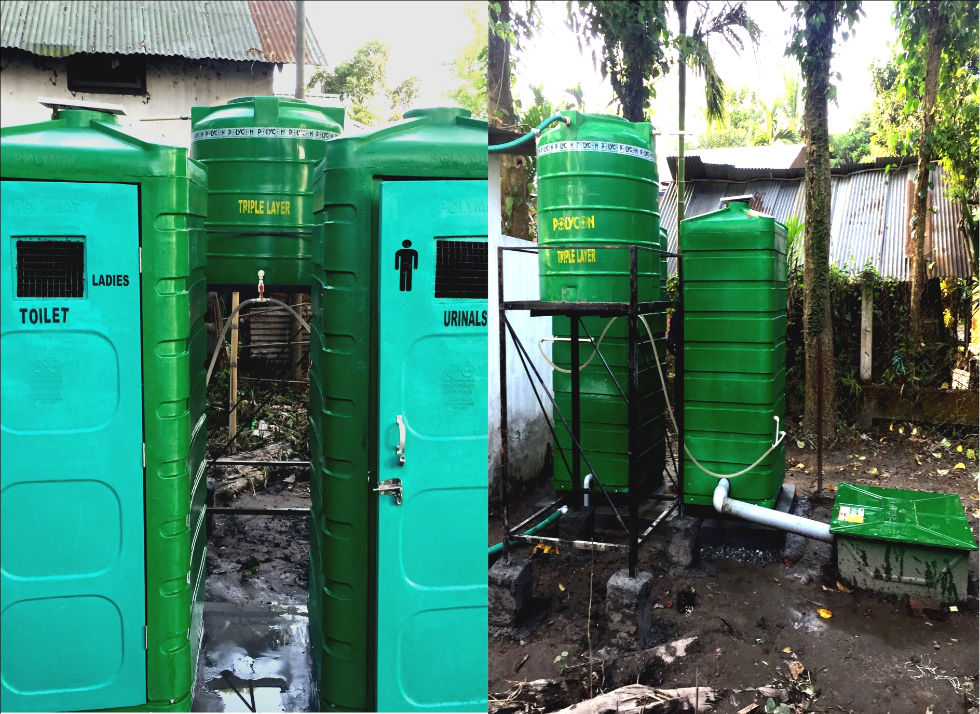
FINAL STAGE OF THE PRODUCT FOR USE
POLYMAT INDUSTRIES
Installed At Pobitora Wild Life Sanctuary , Mayong Assam

Slide 27
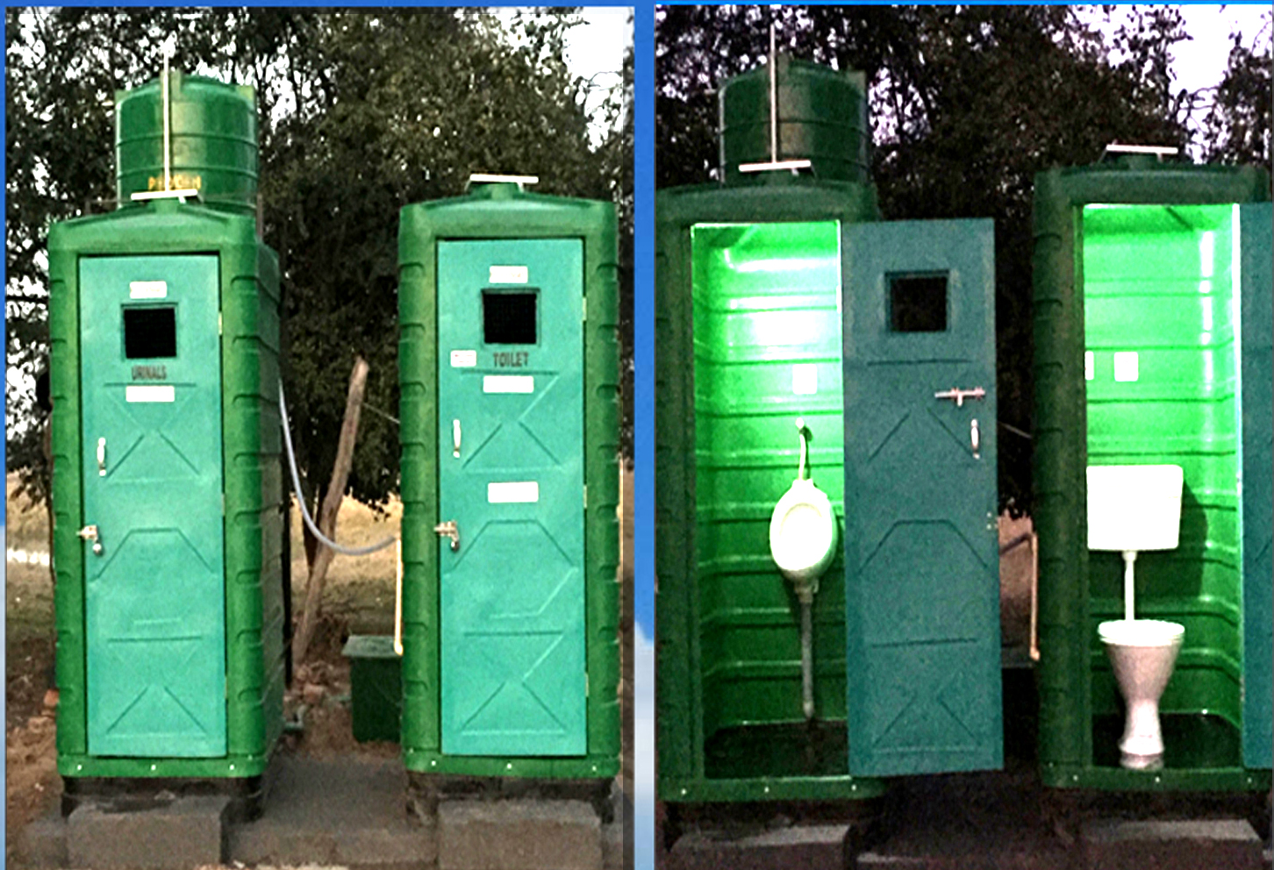
FINISHED PRODUCT FOR USE
POLYMAT INDUSTRIES
Installed At Pobitora Wild Life Sanctuary , Mayong Assam

Slide 28
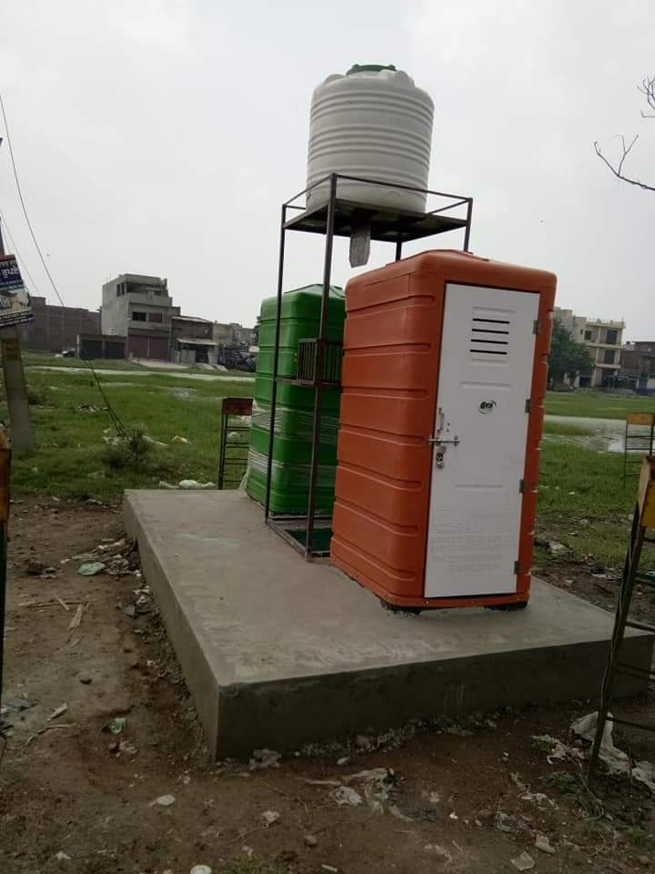
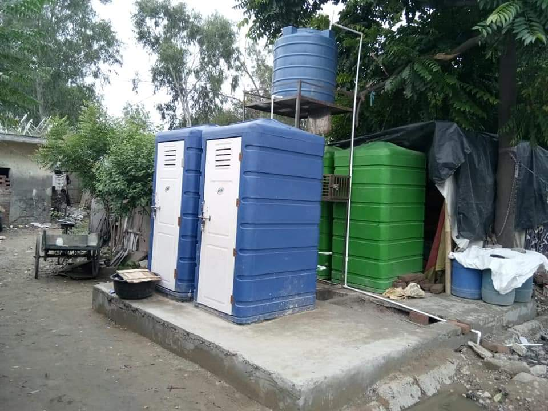
FINISHED PRODUCT FOR USE
POLYMAT INDUSTRIES
FINAL INSTALLED AND READY TO USE

Slide 29
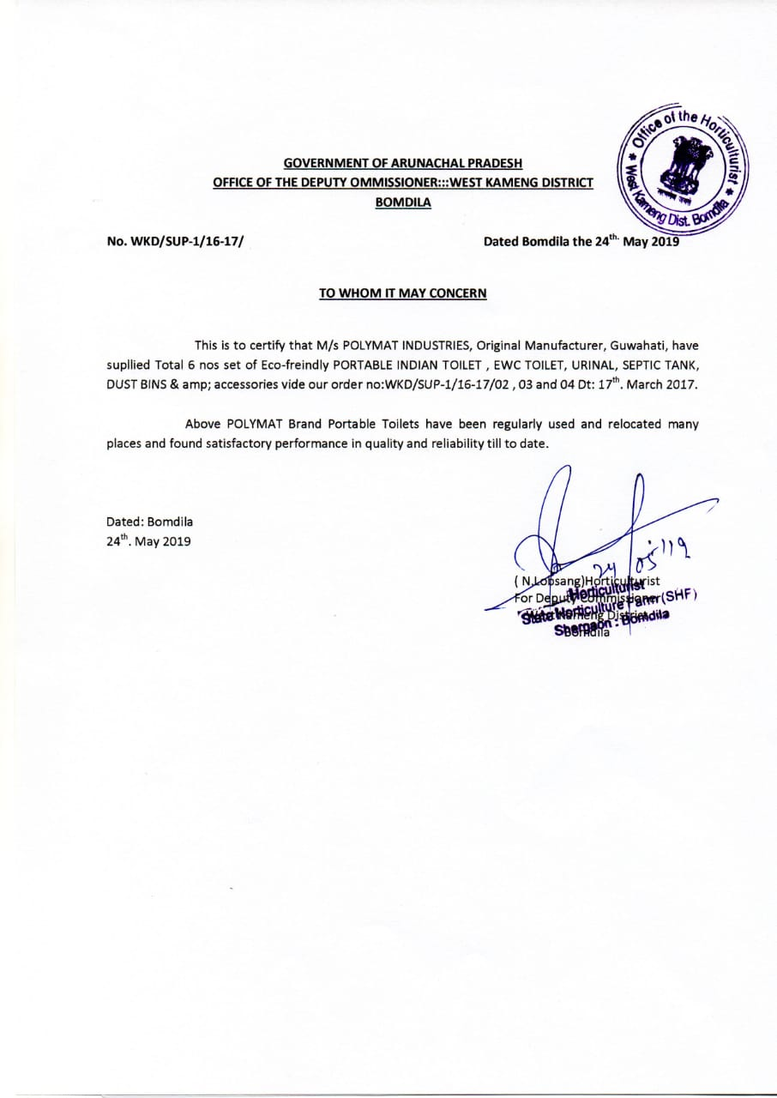
CERTIFICATE
POLYMAT INDUSTRIES

Slide 30

POLYMAT INDUSTRIES
IF EVERY CORNER IS CLEAN
THE ENTIRE NATION IS CLEAN

